Slide 1



Slide 2

WHO
WE ARE?

Slide 3

COMPANY
HISTORY

Slide 4

COMPANY
HISTORY
Merakii is a Greek word, which Personifies Creativity , Innovation and soul put into your work . The company’s strong bond with its customers, intimate relationships with professional and impressive array of award-winning services did not go unnoticed in its fraternity.

Slide 5

Merakii Group has been awarded one of the leading Integrated marketing communication group of India . We believe that your brand is the single most important investment that, you can make in your business. Our Consultants are intrinsic ,that the essence of strategy is choosing what not to do. A Well- defined and executed brand strategy affects all aspects of a business and is directly connected to consumer needs emotions , and competitive environments.

Slide 6


Slide 7
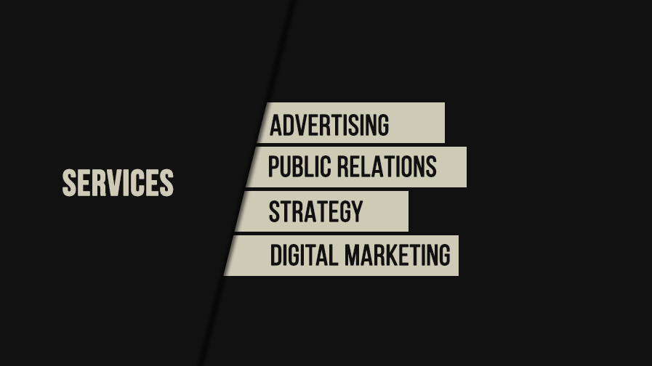

Slide 8

CREATIVE

Slide 9


Slide 10

STRATEGY

Slide 11
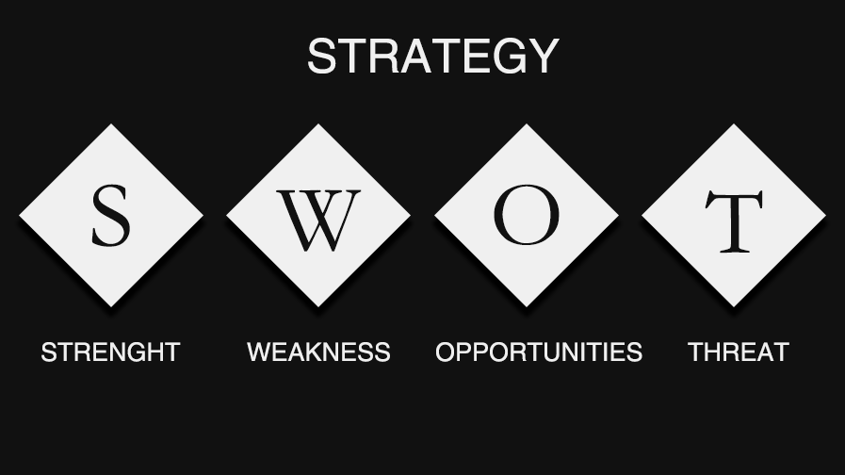

Slide 12


Slide 13

ADVERTISING

Slide 14

BUSINESS
MODEL

Slide 15




SERVICE MODEL
STRATEGIC CONSULTING
CREATIVE CONSULTING
MEDIA CONSULTING
Market Research & Market Intelligence- For Communication Roadmap
Brand Strategy -based on factors effecting the Product/Services to be devised & Proposed.
Content Analysis &Development- Inclusive of Vision & Mission of the Organization.
Brand Strength & Brand Recall
Corporate Communication
Branding & Corporate Identity
Marketing & Sales Collaterals
Print & Web Advertisements
Commercial Production for Radio & Electronic Platforms
Information Design
Packaging
Designs for Gifting & Events
Newsletters & White Papers
Design for Digital Campaigns
Investor Relations
Media Relations
Media Representation
CSR
Crisis Management
Media Advisory

Slide 16



SERVICE MODEL
PRINT
DIGITAL
PRODUCTIONS
Pre-production consultancy
Master artwork
Adaptation artwork
Publication file creation
Color retouching
CGI
Design
Copywriting
Digital supply to publication
Remote proofing
Master creation
Banner adaptation
Rich media & video
Content management systems
HTML, CSS, and Javascript
Responsive design
Mobile apps
Email
Digital OOH
Social content
SEO Implementation
Digital delivery via 3rd
Responsive design
Sound mixing
Casting & production management
Legal clearance & station administration
TV specification checking & quality control
Schedule fulfilment

Slide 17

COMMUNICATION
MAPPING

Slide 18
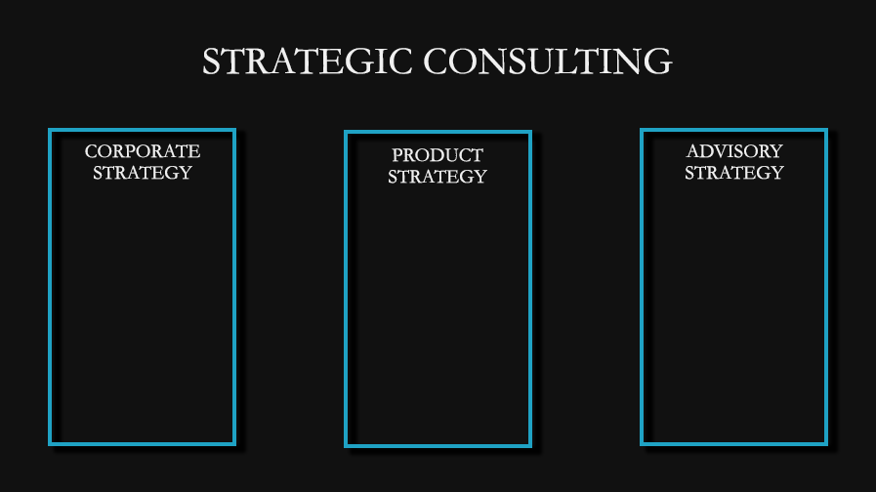
Marketing Strategy including Expansion Strategy, Franchise Strategy, Brand Valuation Strategy etc.
Competitive Mapping, Perception Mapping etc.
Corporate Communication
Product Penetration Strategy including Pricing Strategy, Packaging Strategy, Distribution Strategy etc.
Future Mapping, Technology perception etc.
Legal Advisory
Investor Relations

Slide 19

BRANDING

Slide 20
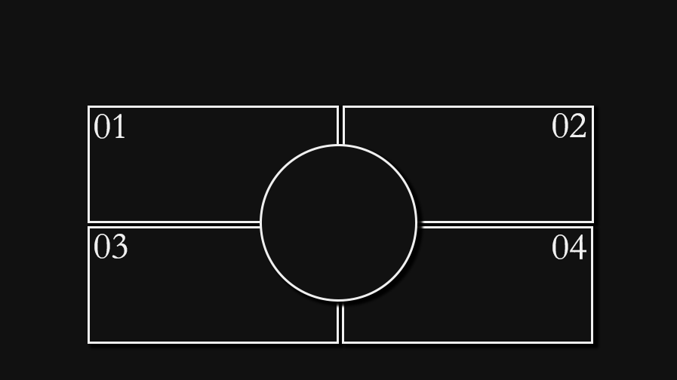
BRAND COMMUNICATION
INTERNAL
COMMUNICATION/
EXTERNAL
COMMUNI CATION
BRAND STRATEGY
Brand Awareness
Market Presence
Customers Engagement
Product Promotions
CONTENT MANAGEMENT
& DRAFTING: FOR ALL
BRAND COMMUNICATION
NEEDS
LEGAL INPUTS

Slide 21
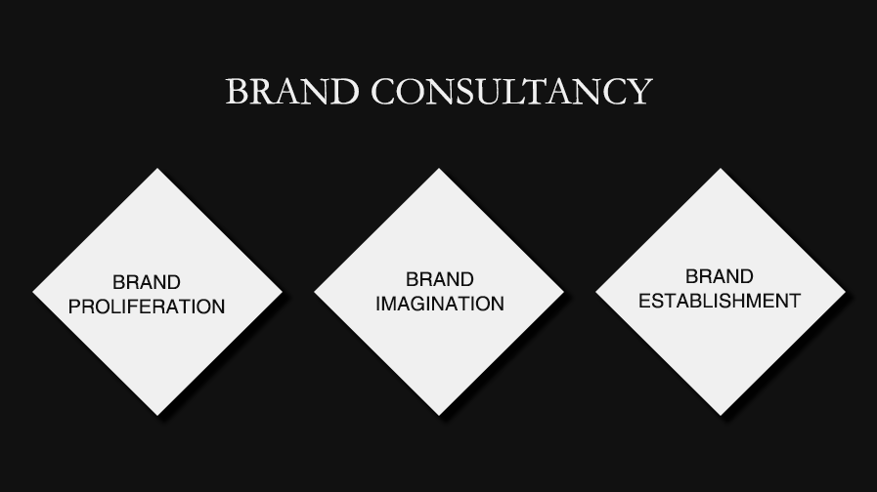

Slide 22

BRAND STRENGTH ANALYSIS
Brand Research
Brand Strategy
Brand Platform
Brand Audits
Internal Research
Industry Research
Competitor Research
Customer Research
Strategic Insights
Brand Positioning
Brand Architecture
Brand Portfolio Optimization
Brand Promises
Brand Personality
Brand DNA
Mission & Vision Statements
Brand Philosophy
Brand Culture
Brand Naming
Brand Tagline
Brand Profiling
Brand Tone

Slide 23
BRAND STRENGTH ANALYSIS
Brand Identity
Brand Collaterals
Brand Packaging
Logo Design
Icon Design
Brand Color
Typography
Visual Language
Brand Imagery
Brand Mascots
Business and Office Stationery
Front & Back Office Documentation
Marketing Collaterals
Training Materials
User Guides
Case Studies
White Papers
Case Studies
Annual Reports
FMCG Products
Industrial Products
IT Products

Slide 24

BRAND PROLIFERATION
Brand Experience
Management
Brand Promotion
Office Branding
Mall Experience
Retail Experience
Brand Interactions
Media Planning
Media Buying
Production
Product Launches
Brand Launches
Integrated Marketing
Merchandize Concepts
Internal Branding
External Branding
Factory Branding
ID Card

Slide 25
BRAND PROLIFERATION
Individual
Branding
Transit Branding
Misc
CXO Branding
Personal Brand Management
Both Online & Offline
Urban Transportation (Airlines, Bus, Trams, Metro, Trains, Taxis)
Corporate Fleet
Logistics Fleet
Brand Music
Brand Texture
Ambient Scenting

Slide 26

OUR
EXPERTISE

Slide 27

BRAND CONFORMANCE
Brand Manual
Brand Training
Brand Protection
Brand Audit
Define your brand standards, personality, values
Appearance and applications of the brand assets across different communication media
Output - Brand Book, Digital Standards, Identity Guidelines, Collateral Standards
Conducted with internal stakeholders
Taught how to communicate the brand in both written and verbal communications.
Conducted before and after the branding process
Determines the efficacy of the brand development
Determines conformity to brand guidelines.
Protection of brand assets with relevant IPR and their misuse

Slide 28

COMMUNICATION PROPOSAL ONLINE/OFFLINE STORE

Slide 29
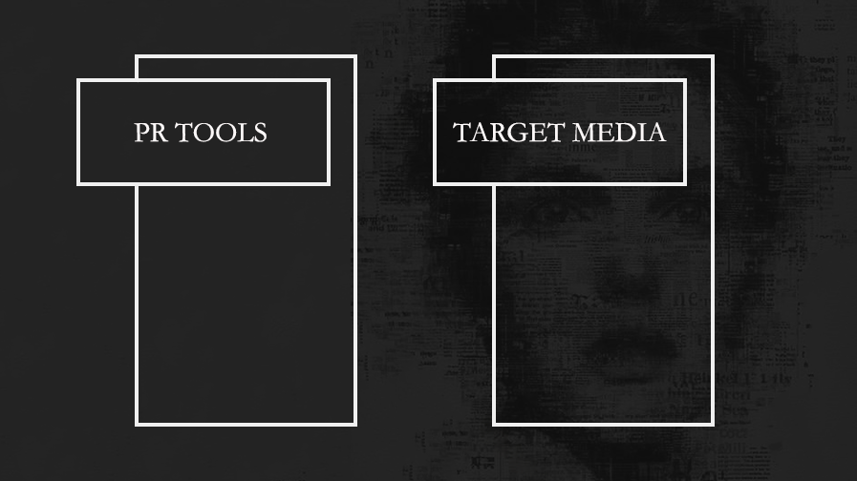
• Press Release
• Corporate stories
• Feature Stories/Tips and Tricks
• Product placement and Sourcing
• Trend Based Stories
• Interviews
• Bridge building meetings
• Industry stories
• Infographics
• Mainlines
• Financials
• TV
• General Magazines
• Lifestyle Magazines
• Online
• Fashion Bloggers

Slide 30

Press Release: this would be published as when required depending on the strength of the message.
Guest/contributory articles: these would be articles written by key personnel on industry trends, market dynamics, etc.
Press Conference: this tool will be sparingly used and would depend on the strength of the message.
Speaker opportunities at relevant forums: this would be used to directly address the target market.
Profiling: this would entail profiling the key personnel in various publications.
Case Studies: of successful implementation of Associate plans at their client locations.
Informal media interaction: this would entail meeting of select press people with the Management of Associates or its representative in India.
PR
OPPORTUNITIES

Slide 31

ACTION
PLAN

Slide 32

ADVANTAGES OF
SOCIAL MEDIA

Slide 33

FREEDOM OF EXPRESSION
Social media allows anyone and everyone to express and share an opinion or idea somewhere along the business’s path to market. Thus the engagement process is then fundamental to successful social media marketing.
PRODUCT PROMOTION
Social networking sites and blogs allow individual followers to “retweet” or “repost” comments made by the product being promoted.

Slide 34
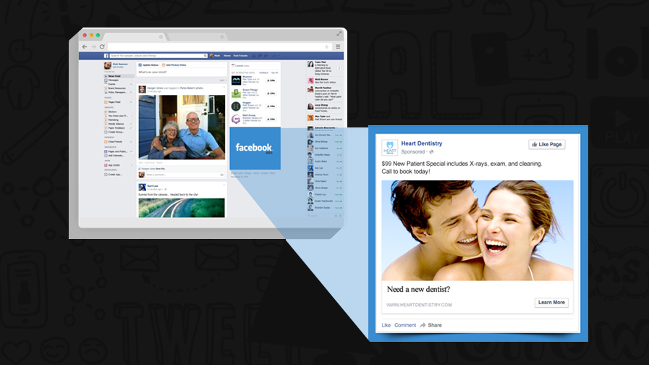
FB ADS
SAMPLE

Slide 35
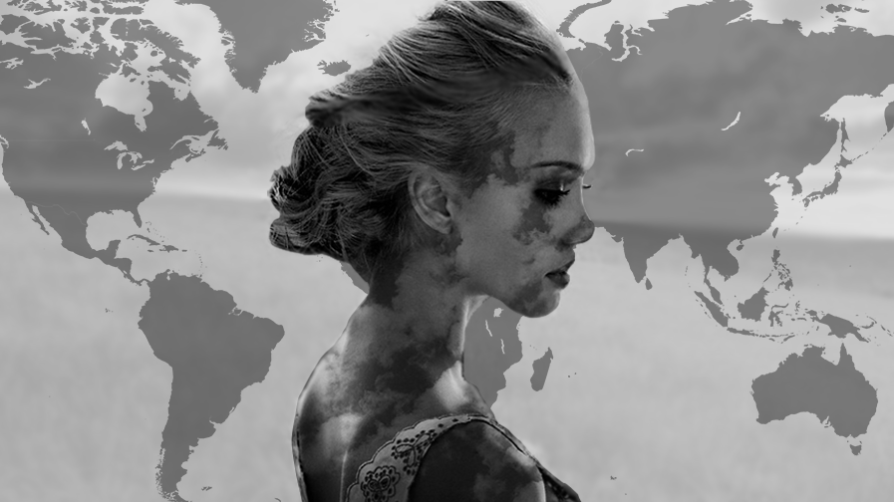
WORLD
WIDE

Slide 36

OUR
PROJECTS

Slide 37
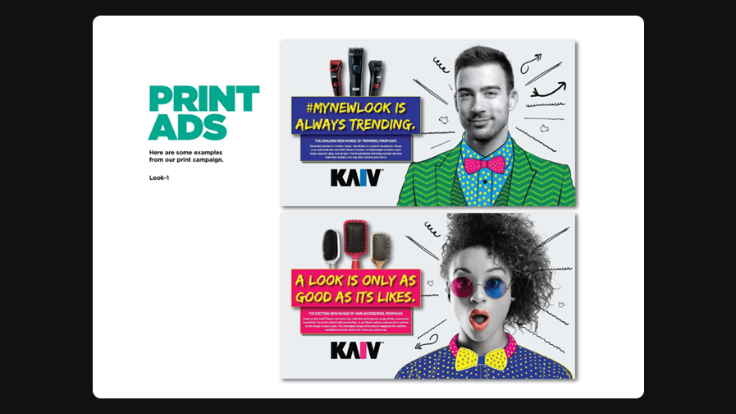
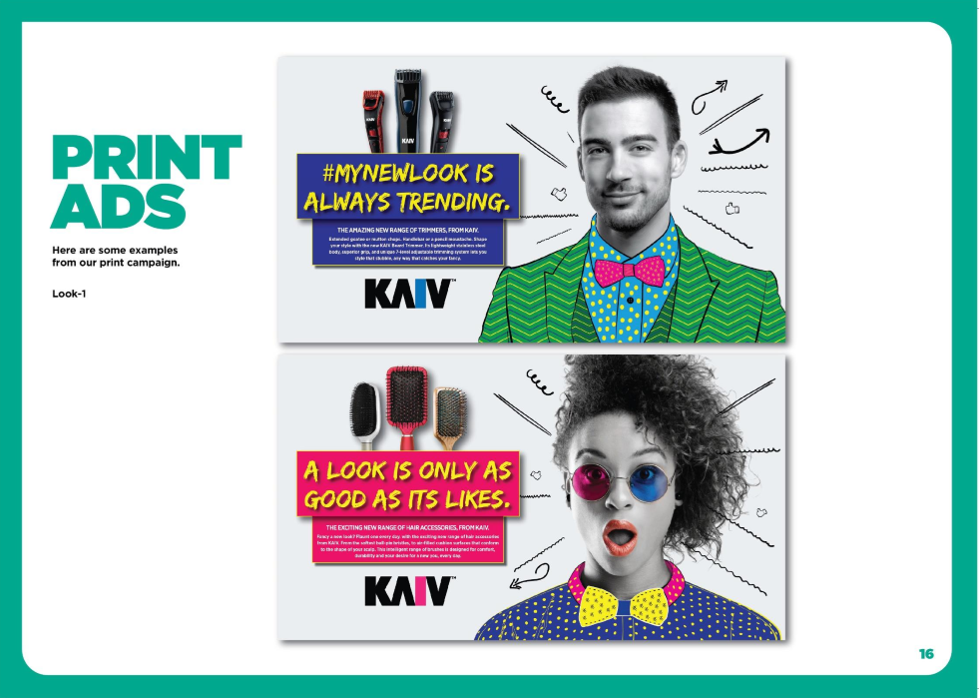

Slide 38
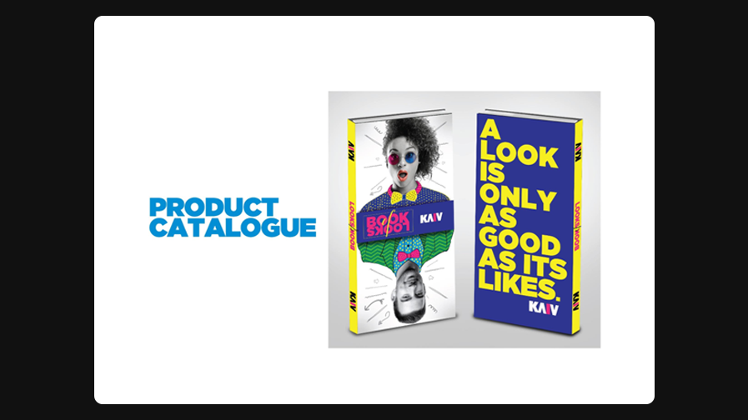
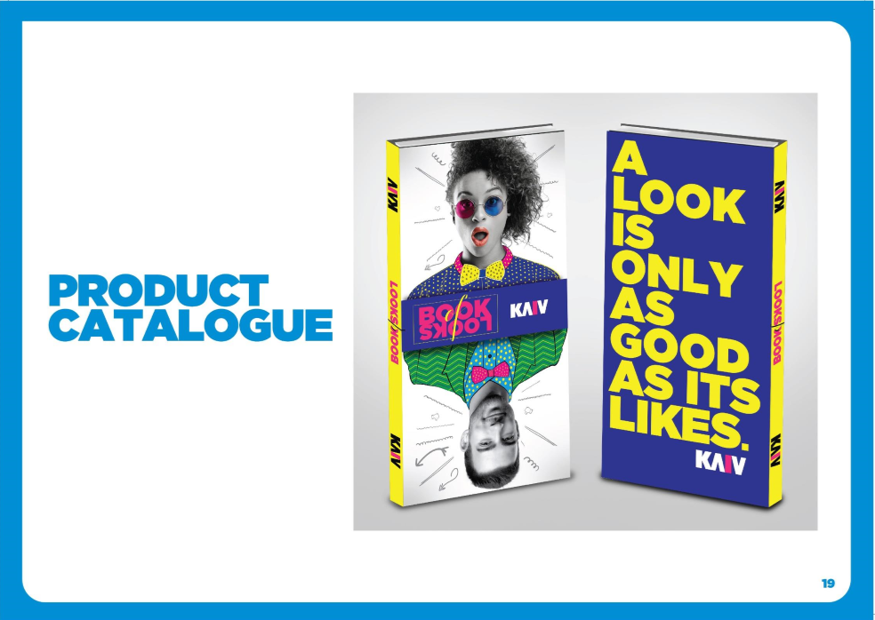

Slide 39
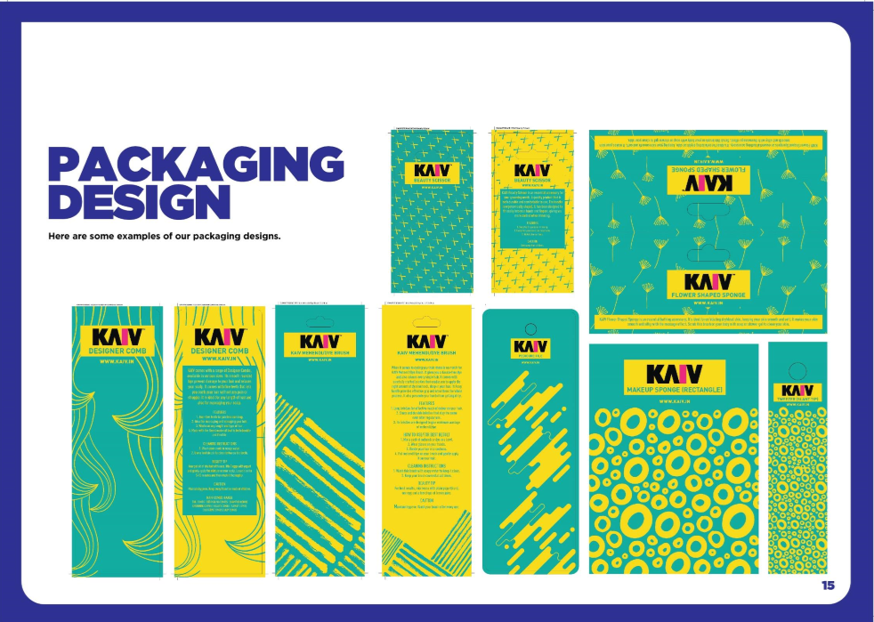


Slide 40
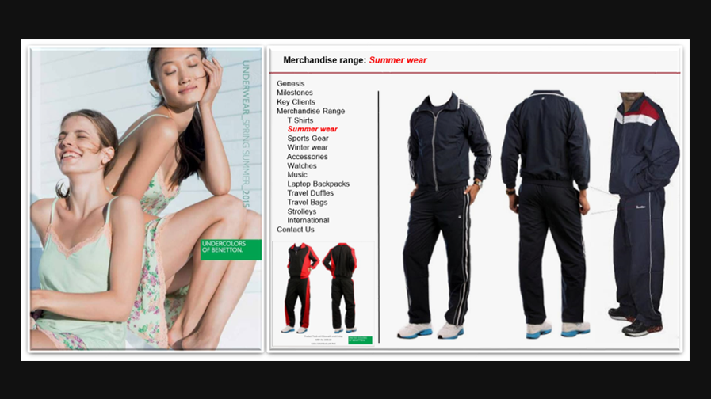

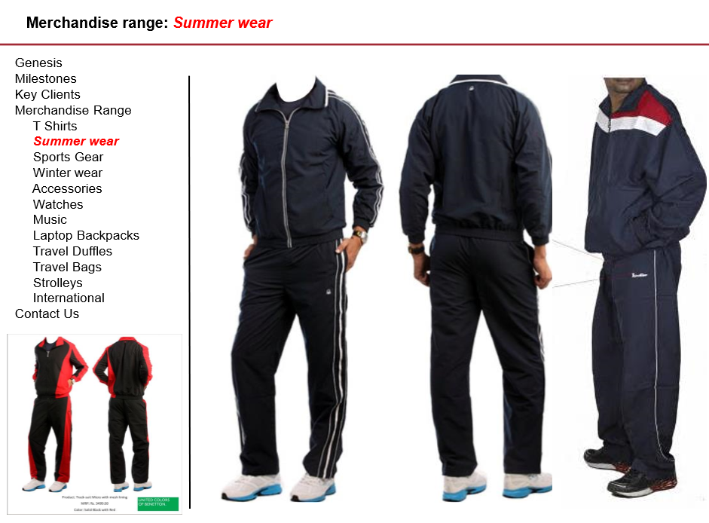

Slide 41


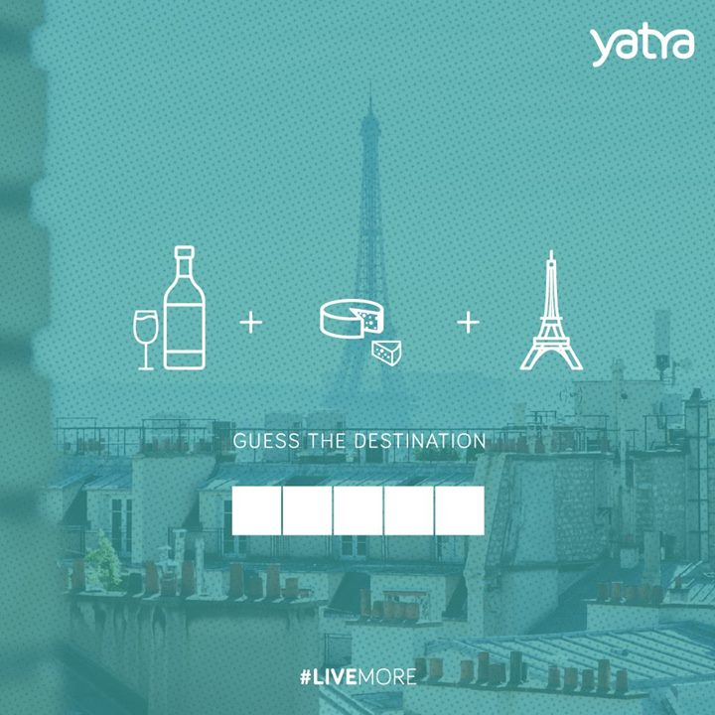

Slide 42
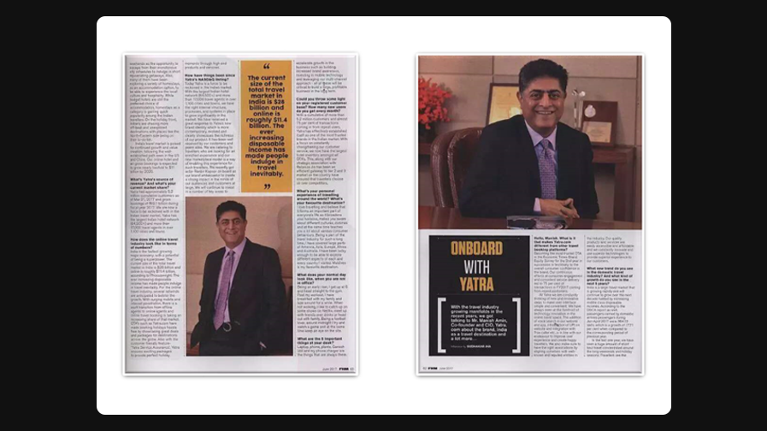
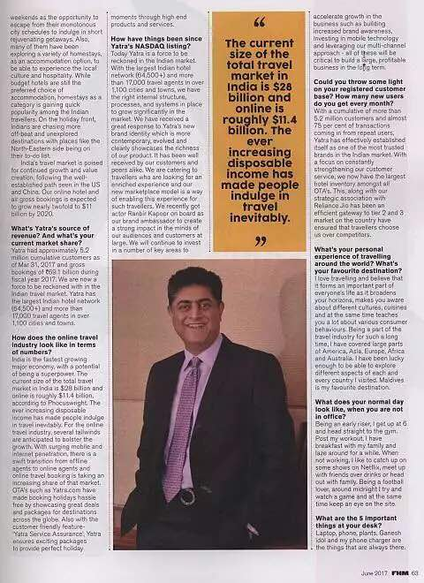
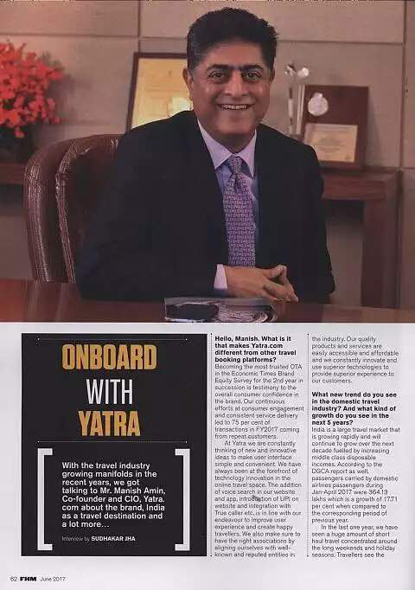

Slide 43

OUR
CLIENTS

Slide 44








Slide 45

DO YOU
HAVE
QUESTIONS?
info@merakii.in
01149042982

Slide 46

THANK
YOU

